Slide 1

Data Communication and Computer Networks
8. Link Layer
PART-A
Dr. Aiman Hanna
Department of Computer Science & Software Engineering Concordia University, Montreal, Canada
These slides has mainly been extracted, modified and updated from original slides of : Computer Networking: A Top Down Approach, 6th edition Jim Kurose, Keith Ross Addison-Wesley, 2013
Additional materials have been extracted, modified and updated from: Understanding Communications and Networking, 3e by William A. Shay 2005
Copyright © 1996-2013 J.F Kurose and K.W. Ross
Copyright © 2005 William A. Shay
Copyright © 2018 Aiman Hanna All rights reserved

Slide 2













Link layer: introduction
terminology:
hosts and routers: nodes
communication channels that connect adjacent nodes along communication path: links
wired links
wireless links
LANs
layer-2 packet: frame, encapsulates datagram
global ISP
data-link layer has responsibility of
transferring datagram from one node
to physically adjacent node over a link
Link Layer A

Slide 3
Link layer: context
datagram transferred by different link protocols over different links:
e.g., Ethernet on first link, frame relay on intermediate links, 802.11 on last link
each link protocol provides different services
e.g., may or may not provide rdt over link
transportation analogy:
trip from Princeton to Lausanne
limo: Princeton to JFK
plane: JFK to Geneva
train: Geneva to Lausanne
tourist = datagram
transport segment = communication link
transportation mode = link layer protocol
travel agent = routing algorithm
Link Layer A

Slide 4
Link layer services
framing, link access:
encapsulate datagram into frame, adding header, trailer
channel access if shared medium
“MAC” addresses used in frame headers to identify source, dest
different from IP address!
reliable delivery between adjacent nodes
we learned how to do this already (chapter 3)!
seldom used on low bit-error link (fiber, some twisted pair)
wireless links: high error rates
Q: why both link-level and end-end reliability?
Link Layer A

Slide 5
Link layer services (more)
flow control:
pacing between adjacent sending and receiving nodes
error detection:
errors caused by signal attenuation, noise.
receiver detects presence of errors:
signals sender for retransmission or drops frame
error correction:
receiver identifies and corrects bit error(s) without resorting to retransmission
half-duplex and full-duplex
with half duplex, nodes at both ends of link can transmit, but not at same time
Link Layer A

Slide 6
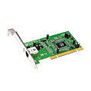
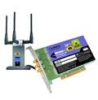

Where is the link layer implemented?
in each and every host
link layer implemented in “adaptor” (aka network interface card NIC) or on a chip
Ethernet card, 802.11 card; Ethernet chipset
implements link, physical layer
attaches into host’s system buses
combination of hardware, software, firmware
application
transport
network
link
cpu
memory
link
physical
host
bus
(e.g., PCI)
controller
physical
transmission
network adapter
card
Link Layer A

Slide 7
Adaptors communicating
datagram
datagram
controller
controller
sending host
receiving host
datagram
frame
sending side:
encapsulates datagram in frame
adds error checking bits, rdt, flow control, etc.
receiving side
looks for errors, rdt, flow control, etc
extracts datagram, passes to upper layer at receiving side
Link Layer A

Slide 8
Data Integrity
a possible reality:
Data transferred → data altered → data received
electrical interference, power fluctuation, sunspots, storms,
…etc. are all factors
error detection is hence needed
what can be done if errors are detected?
error correction may sometimes be the most suitable
solution
Link Layer A

Slide 9
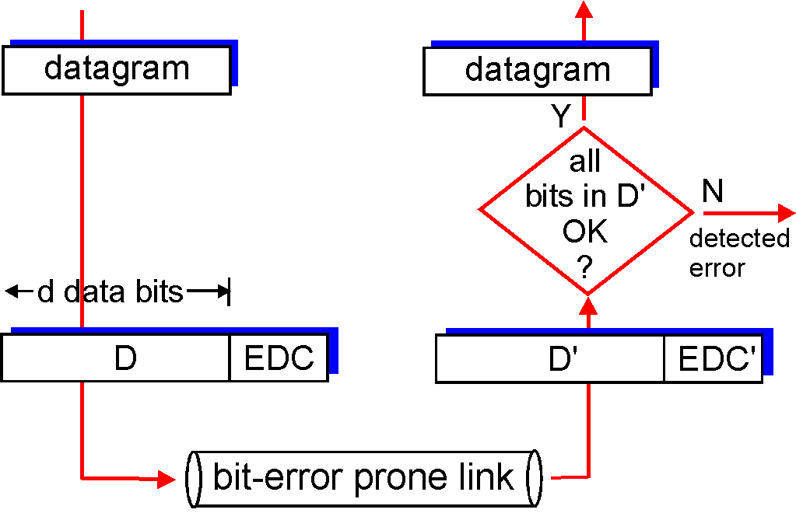
Error detection
EDC = Error Detection and Correction bits (redundancy)
D = Data protected by error checking, may include header fields
Error detection not 100% reliable!
protocol may miss some errors, but rarely
larger EDC field yields better detection and correction
otherwise
Link Layer A

Slide 10
Parity checking
simple/naïve
send additional bits along with data
the value of those additional bits depend on the data itself
theoretically, if data is alerted, the value of the additional bits will no longer correspond to the new data
Link Layer A

Slide 11
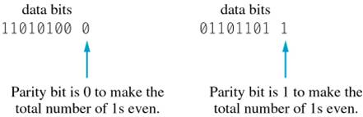
Parity checking
Single-bit parity:
detect single bit errors
parity checking – even parity & odd parity
one parity bit is added to achieve that
Detecting Single-bit Errors Using Even Parity Checking
Link Layer A

Slide 12
Parity checking
how many errors can a parity check detect?
Examples: Assume the use of even parity
Sent: 10100010 1 → Received: 10101010 1 •
Sent: 10011110 1 → Received: 10101110 1 ☑
Sent: 10001110 0 → Received: 11111110 0 •
Sent: 10001110 0 → Received: 11111110 1 ☑
• ≡ Errors detected
☑ ≡ No errors detected
Notice that all the above examples do have errors!
Link Layer A

Slide 13
Parity checking
in reality, single-bit errors are rare
an error for a duration of 1/100 second over a 10Mbps line may affect 10,000 bits
when many bits are damaged, we refer to that as burst errors
in average, parity check would catch about 50% of burst errors
in other words, it is 50% accurate, which is simply not good for communications networks
this however does not mean that parity checking is useless. Why?
Link Layer A

Slide 14
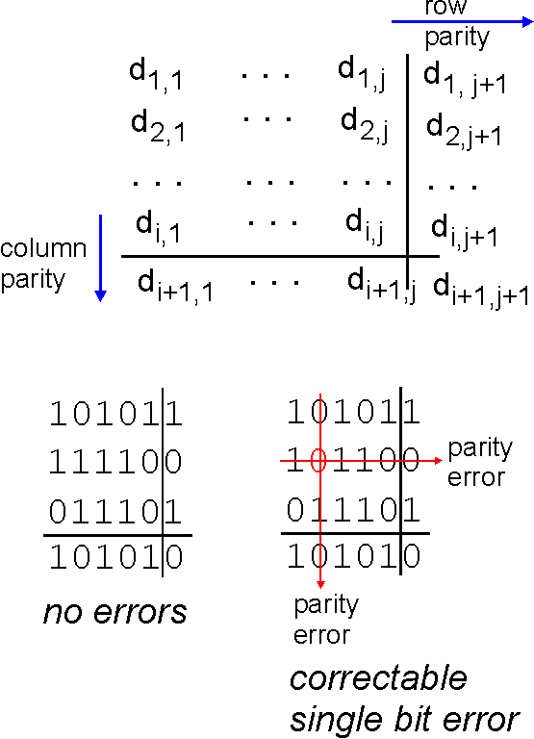
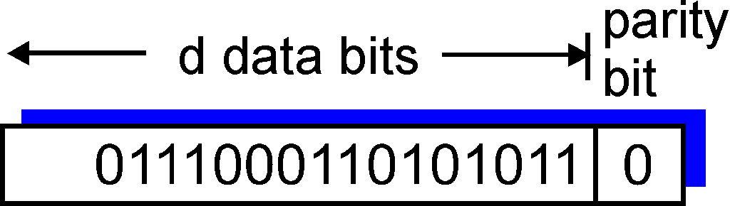
Parity checking
single bit parity:
detect single bit errors
two-dimensional bit parity:
detect and correct single bit errors
0
0
Link Layer A

Slide 15
Checksum
divide all data bits into groups (i.e. 32-bit groups)
treat each group as an integer value
the values are then added together to give a checksum
the checksum is then appended to the sent data and tested at the receiving end
more accurate than parity checking, however it may not detect all errors. Why?
Link Layer A

Slide 16
Internet checksum (review)
goal: detect “errors” (e.g., flipped bits) in transmitted packet (note: used at transport layer only)
sender:
treat segment contents as sequence of 16-bit integers
checksum: addition (1’s complement sum) of segment contents
sender puts checksum value into UDP checksum field
receiver:
compute checksum of received segment
check if computed checksum equals checksum field value:
NO - error detected
YES - no error detected. But maybe errors nonetheless?
Link Layer A

Slide 17
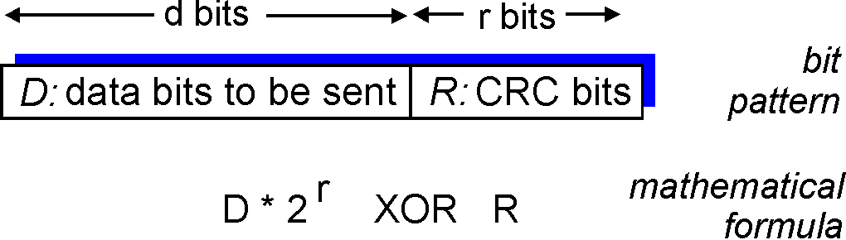
Cyclic Redundancy Check (CRC)
more powerful error-detection coding
view data bits, D, as a binary number
choose bit pattern (generator), G
goal: choose CRC bits, R, such that
<D,R> exactly divisible by G (modulo 2)
receiver knows G, divides received <D,R> by G. If non-zero remainder: error detected!
widely used in practice (Ethernet, 802.11 WiFi, ATM)
Link Layer A

Slide 18
Cyclic Redundancy Check (CRC)
Cyclic Redundancy Checks (CRC) - Details
errors are detected via polynomial division
in general, a polynomial interpretation is made for any bit string
for example, the bit string
b_{n-1}b_{n-2}b_{n-3}…. b₂b₁b₀
is interpreted as the polynomial
b_{n-1}x^{n-1} + b_{n-2}x^{n-2} + b_{n-3}x^{n-3} + ….. + b₂x² + b₁x + b₀
since each bit here is either 0 or 1, we can consider x^{i} only when b=1
for example, the bit string 10010101110
is interpreted as
x¹⁰ + x⁷ + x⁵ + x³ + x² + x¹
Link Layer A

Slide 19
Cyclic Redundancy Check (CRC)
Cyclic Redundancy Checks (CRC) - Polynomial Division
Modulo 2 addition and subtraction (Ex-Or arithmetic) are as follows:
Addition: 0+0=0; 1+0=1; 0+1=1; 1+1=0
Subtraction: 0-0=0; 1-0=1; 0-1=1; 1-1=0
Assume T(x) and G(x) are two polynomials as follows:
T(x) = x¹⁰ + x⁹ + x⁷ + x⁵ + x⁴
G(x) = x⁴ + x³ + x⁰
What is T(x)/G(x)?
Link Layer A

Slide 20
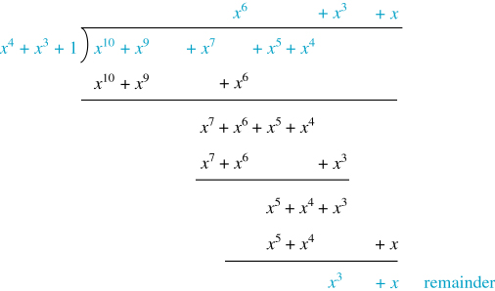
Cyclic Redundancy Check (CRC)
Cyclic Redundancy Checks (CRC) - Polynomial Division
What is T(x)/G(x)?
Calculation of (x¹⁰ + x⁹ + x⁷ + x⁵ + x⁴ )/(x⁴ + x³ + 1 )
Link Layer A

Slide 21
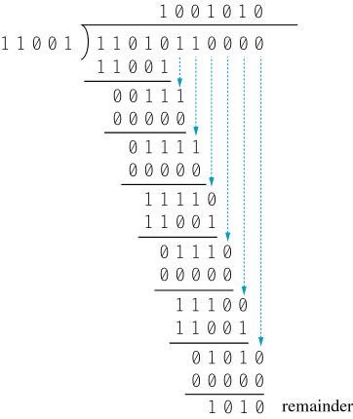
Cyclic Redundancy Check (CRC)
Cyclic Redundancy Checks (CRC) - Polynomial Division
The equivalent synthetic division of T(x)/G(x) would look as follow
Synthetic Division of (x¹⁰ + x⁹ + x⁷ + x⁵ + x⁴ )/(x⁴ + x³ + 1 )
Link Layer A

Slide 22
Cyclic Redundancy Check (CRC)
Cyclic Redundancy Checks (CRC)
How does CRC work?
Given a bit string, append several 0s to it, and call be B
Find the polynomial interpretation of B; that is B(x)
Agree on some polynomial value G(x) (called generator polynomial)
Divide B(x)/G(x) and find the remainder polynomial R(x)
Define T(x) = B(x) – R(x)
Find the bit string of T(x); call it T
Transmit T
Let T’ is the received string
Divide T’(x)/G(x)
➔ if there is a zero remainder then T = T’, which means no errors
Otherwise, errors are detected
Link Layer A

Slide 23
Cyclic Redundancy Check (CRC)
Example: Suppose the bit string 1101011 is to be sent
Assume G(x) = x⁴ + x³ + 1
Append four 0s at the end of the string ➔ B = 11010110000
B(x) = x¹⁰ + x⁹ + x⁷ + x⁵ + x⁴
B(x)/G(x) ➔ The remainder R(x) = x³ + x
T(x) = B(x) – R(x); this can be done by subtracting over the bit strings
11010110000 bit string B
-1010 bit string R
11010111010 bit string T (Notice that T(x)/G(x) has a zero remainder)
In algebra the following analogy is true: If p and q are integers and r is the remainder of p/q, then p-r is evenly divisible by q. for example, 8/3 generates a remainder of 2. 8-2 is evenly divisible by 3.
Link Layer A

Slide 24
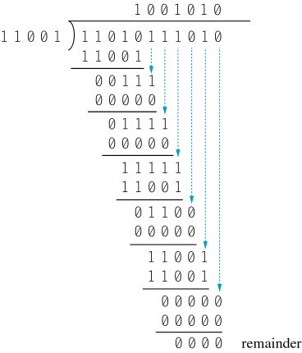
Cyclic Redundancy Check (CRC)
Cyclic Redundancy Checks (CRC)
Example (continues…):
Dividing T(x)/G(x)
Link Layer A

Slide 25
Cyclic Redundancy Check (CRC)
Cyclic Redundancy Checks (CRC)
Example (continues…):
Transmit T
Let T’ is the received string
Divide T’(x)/G(x)
➔ if there is a zero remainder then T = T’, which means no errors
Otherwise, errors are detected
Notes: In practice the following holds true:
A non-zero remainder concludes that errors have occurred
A zero remainder however is not that conclusive. Unless G(x) is chosen carefully, it is possible that a damaged T’ may still result in a zero remainder when T’(x) is divided by G(x)
Link Layer A

Slide 26
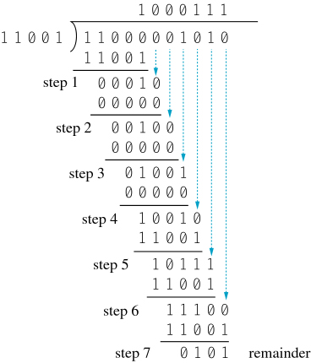
Cyclic Redundancy Check (CRC)
CRC Implementation Using Circular Shifts
Performing CRC check for each data arrival is a massive overhead
How fast can the polynomial division be performed? Does it have to be complete?
Dividing T(x)/G(x) When Error Occurs
Link Layer A

Slide 27
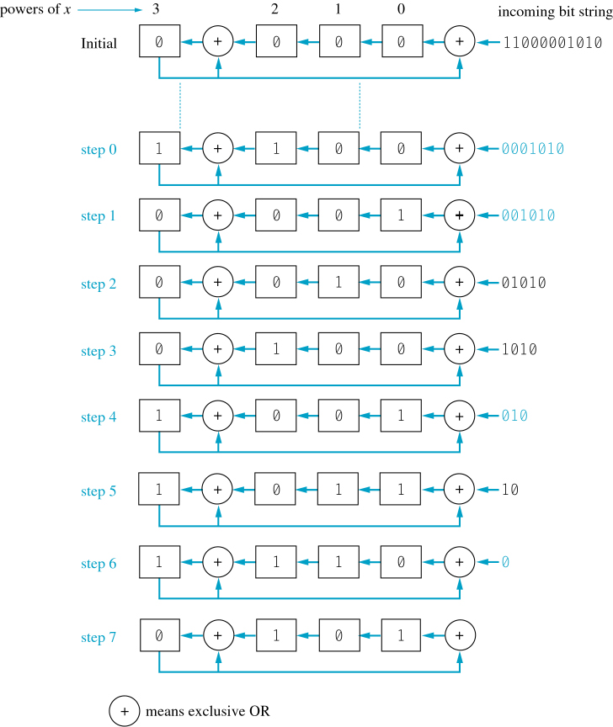
Cyclic Redundancy Check (CRC)
CRC Implementation Using Circular Shifts
division using circular shifts
Dividing T(x)/G(x) Using Circular Shift
[G(x) = x⁴ + x³ + 1
& hardware has 4 registers]
Link Layer A

Slide 28



Multiple access links, protocols
two types of “links”:
point-to-point
i.e. point-to-point link between Ethernet switch, host
broadcast (shared wire or medium)
old-fashioned Ethernet
802.11 wireless LAN
shared wire (e.g.,
cabled Ethernet)
shared RF
(e.g., 802.11 WiFi)
shared RF
(satellite)
humans at a
cocktail party
(shared air, acoustical)
Link Layer A

Slide 29
Network topologies
a network is a system connecting different devices
the connection strategy to connect these devices is referred to as Network Topology
the best topology depends on the network needs
possible network topologies are:
Common Bus Topology
Star Topology
Ring Topology
Fully Connected Topology
Tree Topology
Combined Topology
Link Layer A

Slide 30
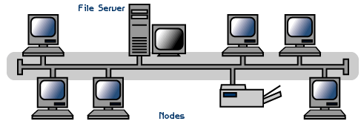
Common bus topology
simply known as Bus Topology or Linear Bus Topology
terminators are placed at both ends
Link Layer A

Slide 31
Common bus topology
collision is possible
a collision results on noise
the interfaces detect the noise on the bus, stop transmission, wait for a random amount of time then attempt transmission again
this process is called Carrier Sense Multiple Access with Collision Detection (CSMA/CD)
the Ethernet (original configuration) is an example of a common bus network
Advantages?
Disadvantages?
Link Layer A

Slide 32
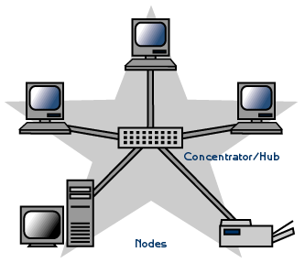
Star Topology
the central component is commonly called hubs or switches
Advantages?
Disadvantages?
Link Layer A

Slide 33
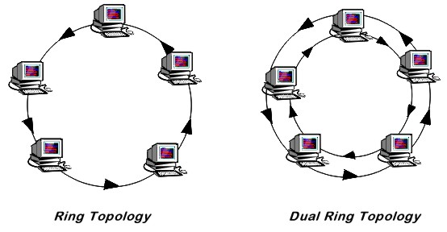
Ring Topology
the ring can either be unidirectional or bidirectional (dual)
IBM’s Token Ring network is an example of a ring topology, where a token (sequence of bits) is passed between the devices.
Advantages?
Disadvantages?
Link Layer A

Slide 34

Fully-Connected Topology
a direct link is there between each pair of devices in the network; this design is extreme
Advantages?
Disadvantages?
Link Layer A

Slide 35
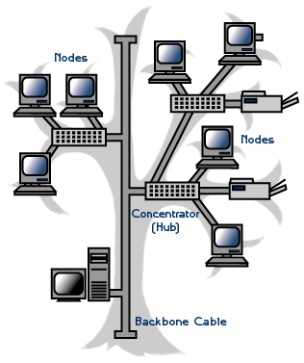
Tree Topology
combines characteristics of linear bus and star topologies
allows for the expansion of an existing network
Advantages?
Disadvantages?
Link Layer A

Slide 36
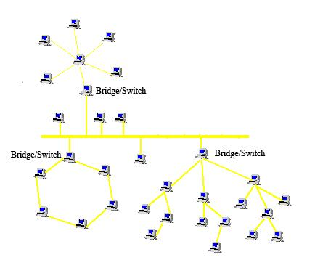
Combined topologies
used by many computer networks
groups of specialized users may need to have a separate LAN
different LANs are connected through bridges/switches
Link Layer A

Slide 37
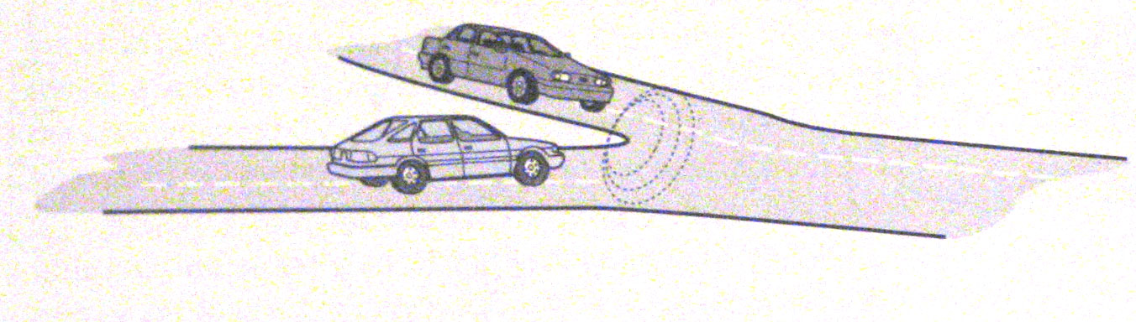
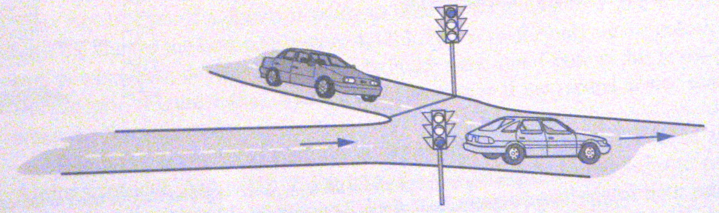
Contention protocols
access to the medium from many entry points is called contention
unless controlled, contention may lead to fatal problems
contention protocols are used to avoid such problems
No Contention Protocol
Stop-and-Go Access Protocol
Link Layer A

Slide 38
Multiple access protocols
single shared broadcast channel
two or more simultaneous transmissions by nodes: interference
collision if node receives two or more signals at the same time
multiple access protocol
distributed algorithm that determines how nodes share channel, i.e., determine when node can transmit
communication about channel sharing must use channel itself!
no out-of-band channel for coordination
Link Layer A

Slide 39
An ideal multiple access protocol
given: broadcast channel of rate R bps
desiderata:
1. when one node wants to transmit, it can send at rate R.
2. when M nodes want to transmit, each can send at average rate R/M
3. fully decentralized:
no special node to coordinate transmissions
no synchronization of clocks, slots
4. simple
Link Layer A

Slide 40
MAC protocols: taxonomy
three broad classes:
channel partitioning
divide channel into smaller “pieces” (time slots, frequency, code)
allocate piece to node for exclusive use
random access
channel not divided, allow collisions
“recover” from collisions
“taking turns”
nodes take turns, but nodes with more to send can take longer turns
Link Layer A

Slide 41
Channel partitioning MAC protocols: TDMA
TDMA: time division multiple access
access to channel in "rounds"
each station gets fixed length slot (length = pkt trans time) in each round
unused slots go idle
example: 6-station LAN, 1,3,4 have pkt, slots 2,5,6 idle
6-slot
frame
6-slot
frame
1
3
4
1
3
4
Link Layer A

Slide 42
Channel partitioning MAC protocols: FDMA
FDMA: frequency division multiple access
channel spectrum divided into frequency bands
each station assigned fixed frequency band
unused transmission time in frequency bands go idle
example: 6-station LAN, 1,3,4 have pkt, frequency bands 2,5,6 idle
time
frequency bands
FDM cable
Link Layer A

Slide 43
Random access protocols
when node has packet to send
transmit at full channel data rate R.
no a priori coordination among nodes
two or more transmitting nodes ➜ “collision”
random access MAC protocol specifies:
how to detect collisions
how to recover from collisions (e.g., via delayed retransmissions)
examples of random access MAC protocols:
ALOHA
slotted ALOHA
CSMA, CSMA/CD, CSMA/CA
Link Layer A

Slide 44
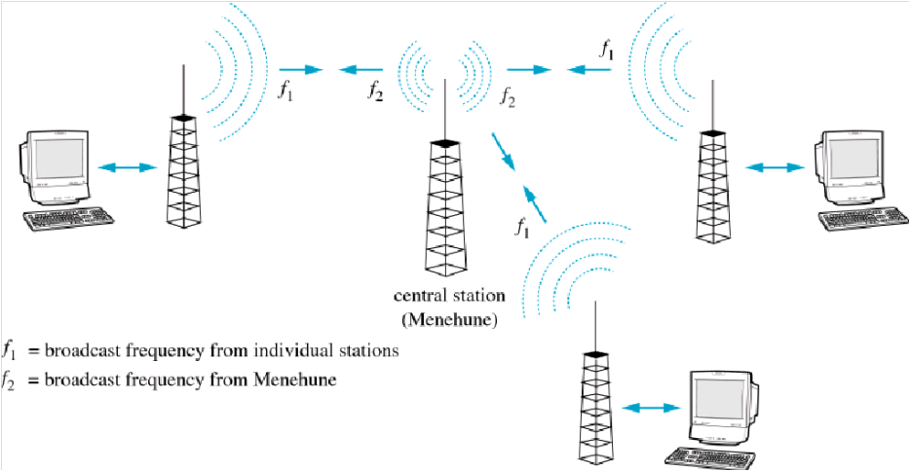
ALOHA protocols
earliest contention protocol in 1970s by Univ. of Hawaii, called Pure ALOHA
several stations to central station (Menehune) by radio communication
f₁ for broadcast, f₂ (different frequency than f₁) for ACK
any station can transmit; if collision then wait random time
Aloha System
Link Layer A

Slide 45
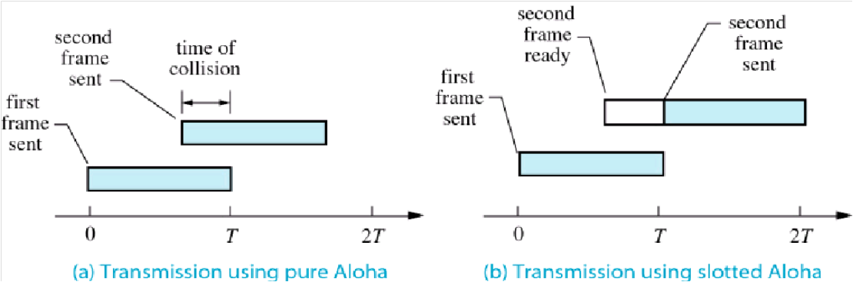
Slotted ALOHA
any overlap in signals, even a small one, would force retransmission
hence, a minimal safe period to transmit two signals is 2T (T is time period)
so, to allow a device to transmit, you should reserve 2T for that
not to waste such time, Slotted Aloha is used
devices can only send at the beginning of each slot
Transmission Using Pure Aloha & Slotted Aloha
Link Layer A

Slide 46
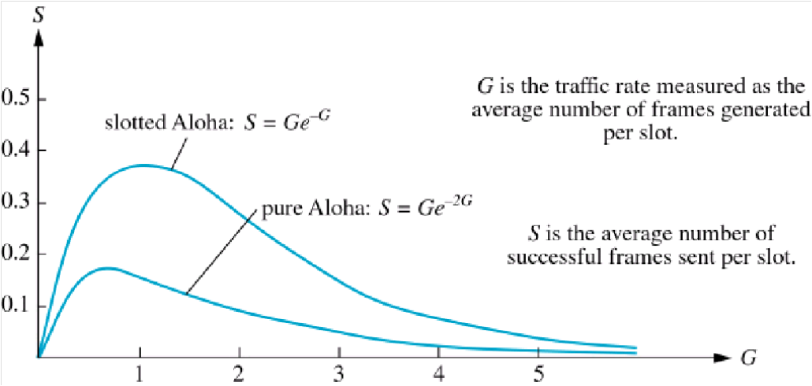
Slotted ALOHA: efficiency
Slotted Aloha has a higher success rate than Pure Aloha
however, with increased traffic, the different may not be that significant
Success Rate for Pure Aloha & Slotted Aloha
Link Layer A

Slide 47
Carrier Sense Multiple Access (CSMA)
CSMA: listen before transmit:
if channel sensed idle: transmit entire frame
if channel sensed busy, defer transmission
human analogy: don’t interrupt others!
Link Layer A

Slide 48
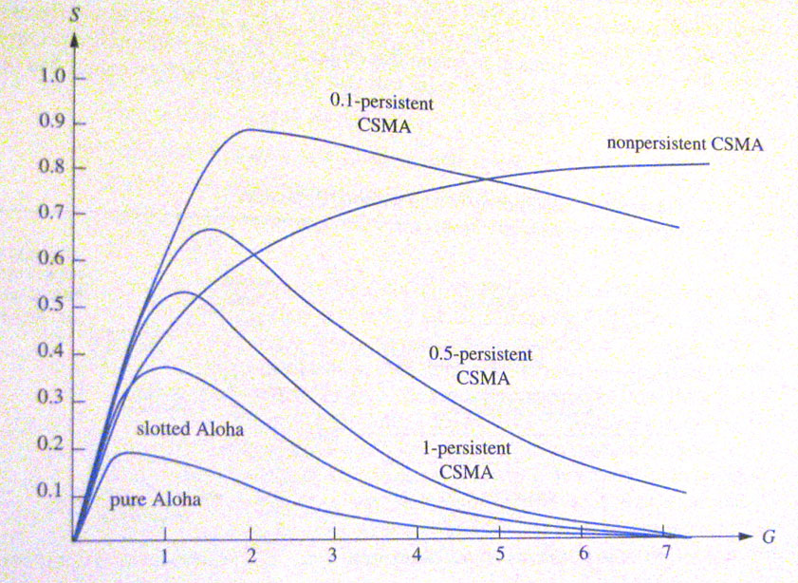
Carrier Sense Multiple Access (CSMA)
Carrier Sense Multiple Access Protocols (CSMA)
sense the medium at the beginning of a slot, send if the medium is free, else wait for next slot
p-persistent CSMA:
Continue to sense the active medium
If free, send with a probability p (0 < p ≤ 1)
p=0 never transmits (wait again) ;
p=1 always transmits (collision chances are higher)
Nonpersistent CSMA: check periodically, if free send else wait for one time slot and check again
Success Rate for CSMA & Aloha Protocols
Link Layer A

Slide 49
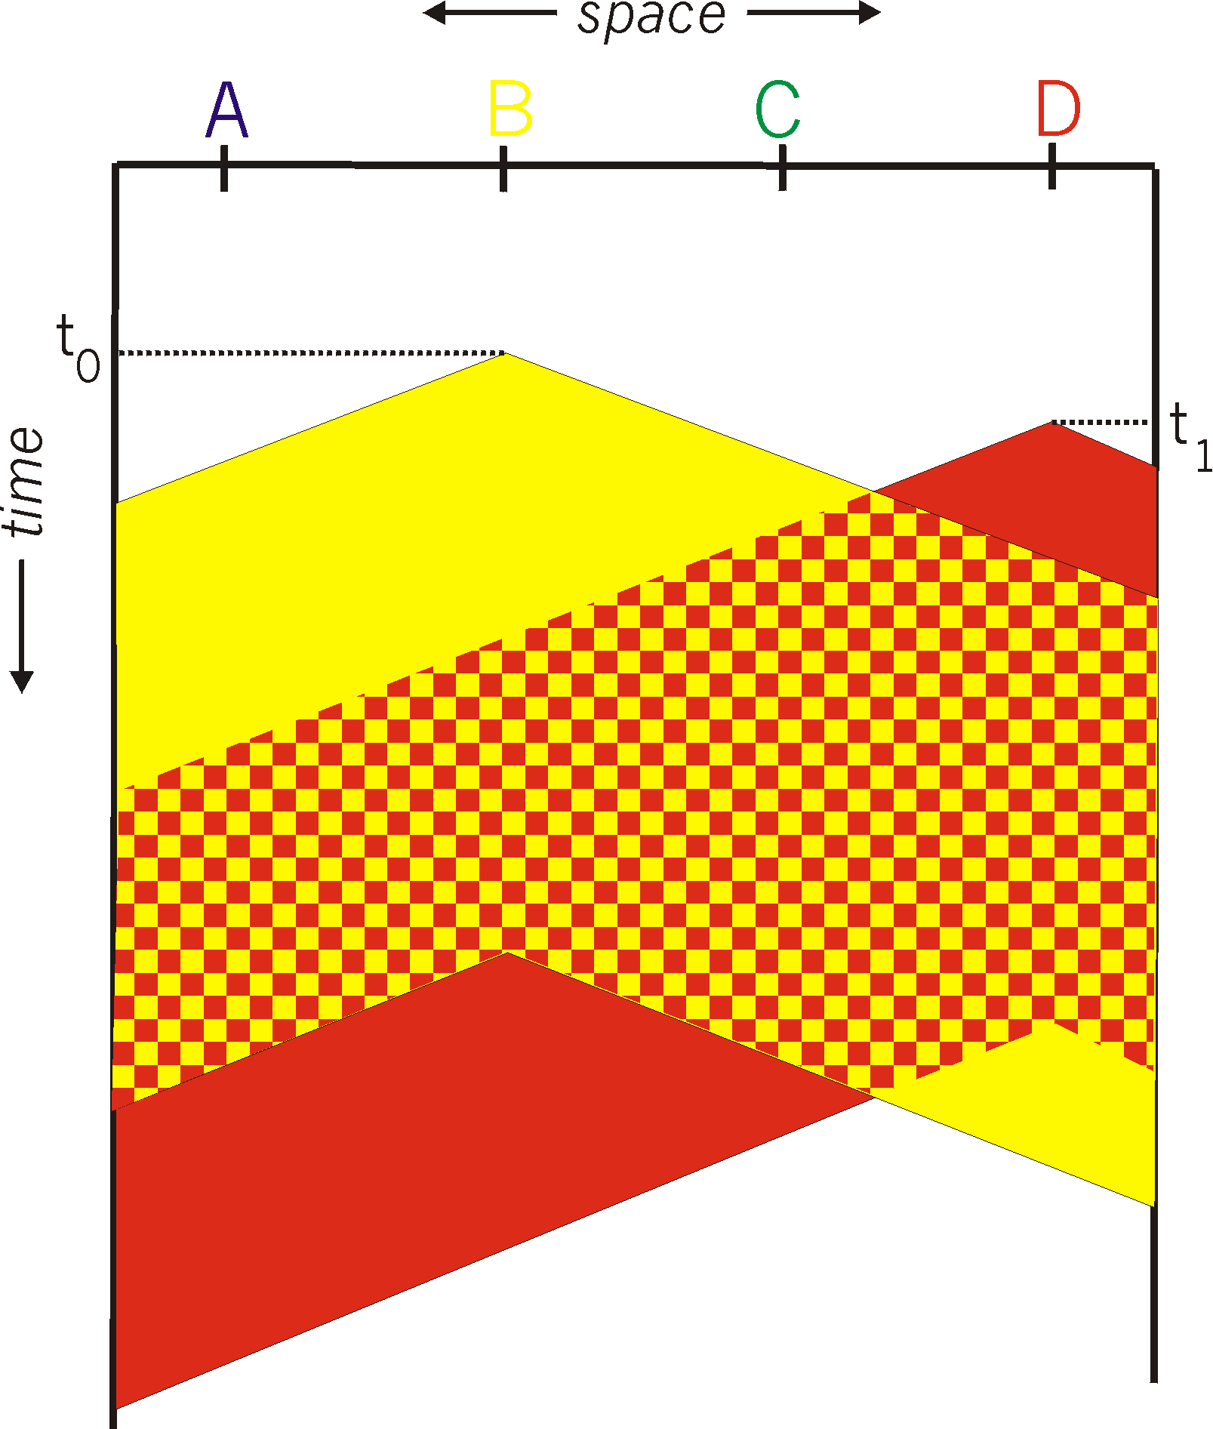
CSMA collisions
spatial layout of nodes
collisions can still occur: propagation delay means two nodes may not hear each other’s transmission
collision: entire packet transmission time wasted
distance & propagation delay play role in in determining collision probability
Link Layer A

Slide 50
CSMA/CD (Collision Detection)
CSMA/CD: carrier sensing, deferral as in CSMA
collisions detected within short time
colliding transmissions aborted, reducing channel wastage
collision detection:
easy in wired LANs: measure signal strengths, compare transmitted, received signals
difficult in wireless LANs: received signal strength overwhelmed by local transmission strength
human analogy: the polite conversationalist
Link Layer A

Slide 51
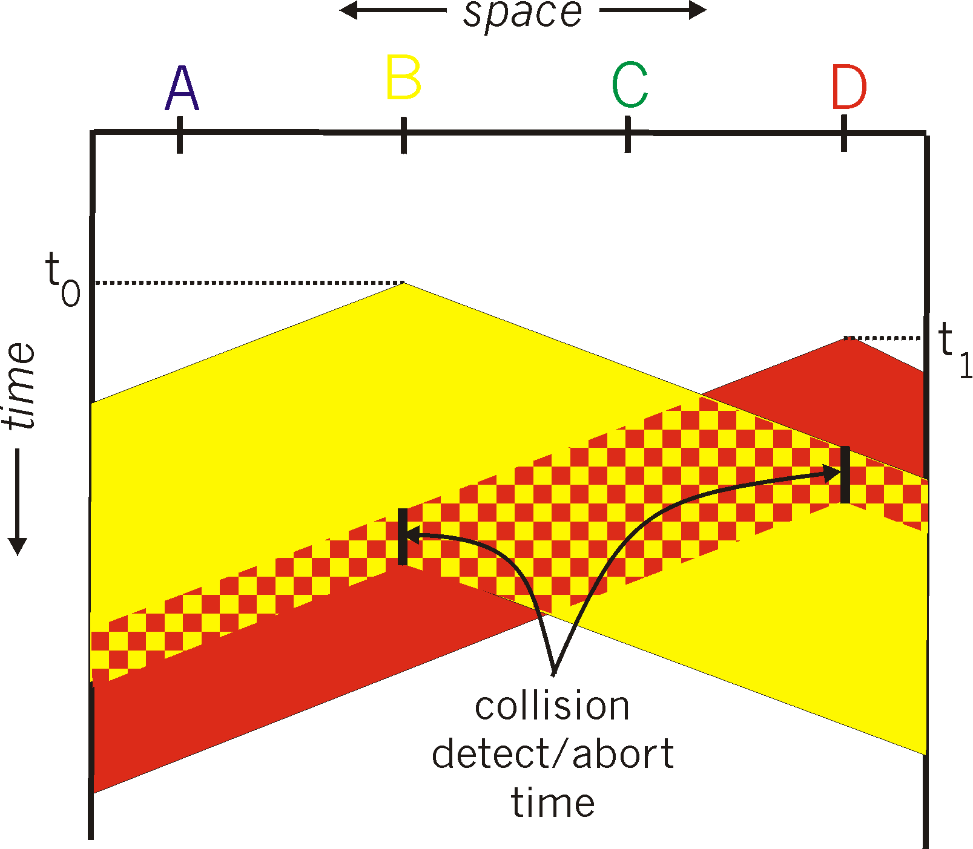
CSMA/CD (collision detection)
spatial layout of nodes
Link Layer A

Slide 52
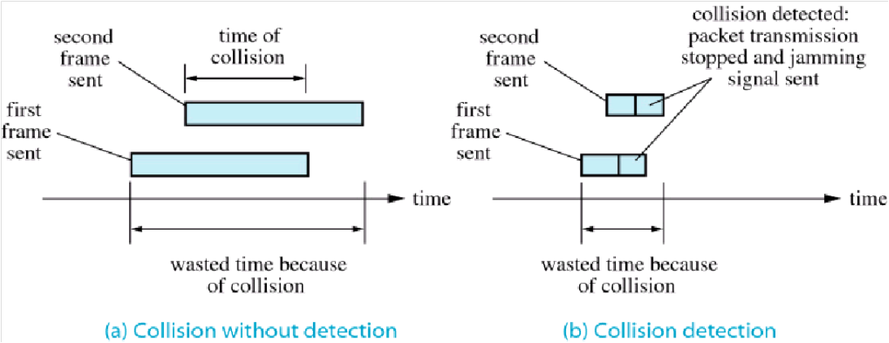
Collision detection (CD)
instead of sending entire frame then discover that collision has occurred when no ack is received, sense the medium for collision and stop transmitting if occurs
this will avoid the medium from being unusable during collision
Commonly used with CSMA – called CSMA/CD
Collision with and without Detection
Link Layer A

Slide 53
Collision detection (CD)
two issues worth considering:
frame size
distance
frame size:
the frame has to be of a minimum size so the device can detect collision before it finishes
if too large, a device can monopolize the medium
so, how small should a frame be?
depends on the maximum time it takes to detect collision
Link Layer A

Slide 54
Collision detection (CD)
Example: Assume:
10 Mbps bit rate,
Largest distance between two devices is 2 KM
Signal propagate at a rate of 200 meter/µsec
To propagate 2 KM it takes 10 µsec
To propagate 4 KM (worst case, go & come back), we need 20 µsec
Rate of 10 Mbps is the same as 10 bits each µsec
In 20 µsec we have 200 bits or 200/8 = 25 bytes
This is the minimum size a frame can be so CD can be made

Slide 55
Collision detection (CD)
the other issue with CD is distance
for example CD does not work well with satellite since the time needed to travel back and forth between ground and satellite is too big due to the large distance
Binary exponential back-off algorithm
varies the waiting time before sending again if collision occurred
if first collision then wait 0, or 1 slots
second collision then wait randomly for 0, 1, 2, or 3 slots
..........................…
…………………..
if n successive collisions then wait for random # of slots between 0 and 2^{n}-1, when n > 16 give-up and signal to higher layer!
Link Layer A

Slide 56
Token passing
instead of sending whenever it wishes, a device will take turns in sending with the other ones
capture token to send data frame
if data then remove token and transmit data frame; else pass token to neighbor
only sender can put the token back on ring after receiving it back
one frame per token
advantage: contention is much controlled than the previous protocols
Disadvantages:
All devices must be known
Complexity (what happen if the token is lost or if the device that has control over it fails)
Link Layer A

Slide 57
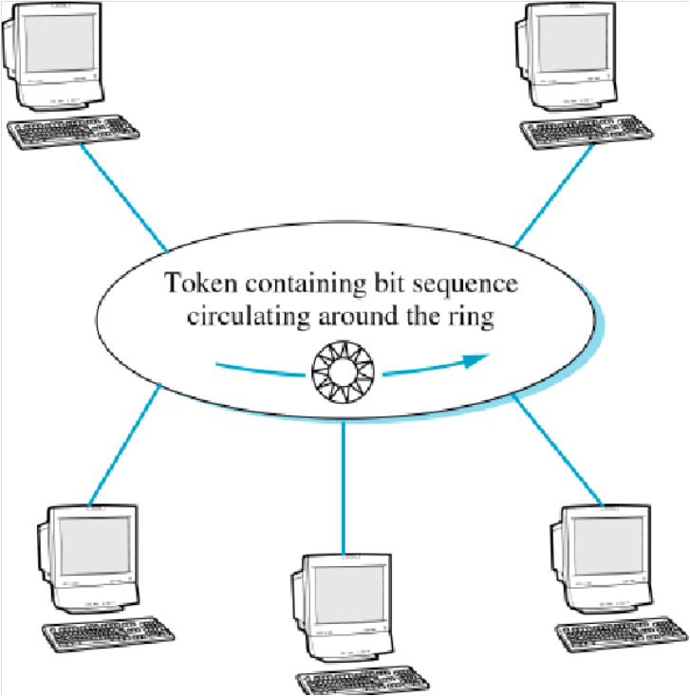
Token passing
Token Ring Network
Link Layer A

Slide 58



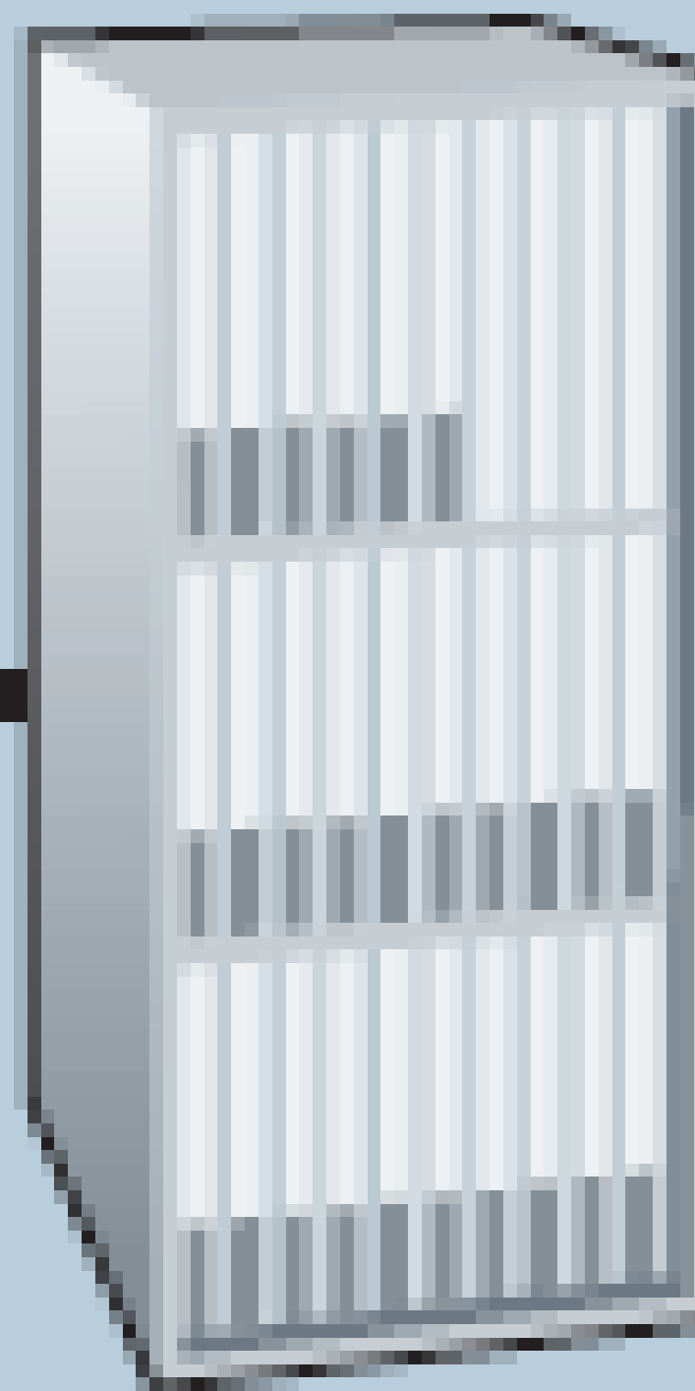
Cable access network
Internet frames,TV channels, control transmitted
downstream at different frequencies
cable headend
…
CMTS
…
splitter
cable
modem
cable modem
termination system
ISP
upstream Internet frames, TV control, transmitted
upstream at different frequencies in time slots
multiple 40Mbps downstream (broadcast) channels
single CMTS transmits into channels
multiple 30 Mbps upstream channels
multiple access: all users contend for certain upstream channel time slots (others assigned)
Link Layer A

Slide 59

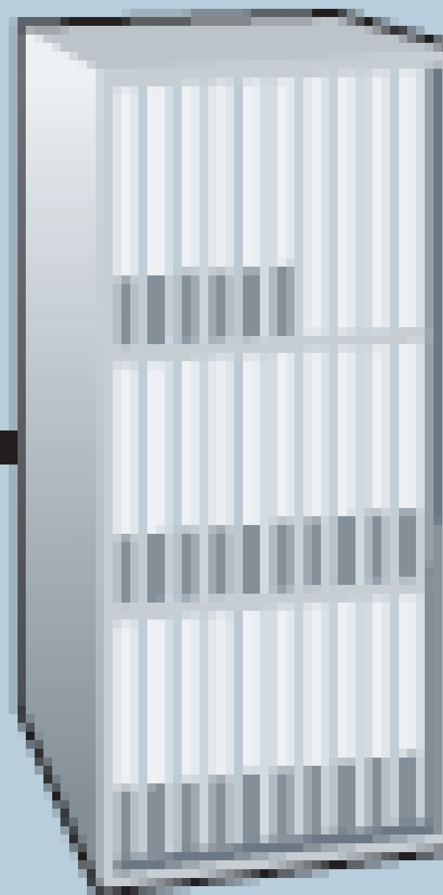
Cable access network
cable headend
MAP frame for
Interval [t1, t2]
CMTS
Downstream channel i
Upstream channel j
t₁
t₂
Residences with cable modems
Minislots containing
minislots request frames
Assigned minislots containing cable modem
upstream data frames
DOCSIS: data over cable service interface spec
FDM over upstream, downstream frequency channels
TDM upstream: some slots assigned, some have contention
downstream MAP frame: assigns upstream slots
request for upstream slots (and data) transmitted random access (binary backoff) in selected slots
Link Layer A

Slide 60
Error correction
when errors are detected, either resend the message or correct it
in many cases correction will be a much better choice
1 parity bit check → 2 possibilities
whether or not an error occurred; but not where
2 parity bit checks → 4 possibilities of failures and successes
3 parity bit checks → 8 possibilities of failures and successes
n parity bit checks → 2^{n} possibilities of failures and successes
Link Layer A

Slide 61
Error correction
how many single-error possibilities are there in the a 3-bit string, for example m₁ m₂ m₃?
1 parity check → whether or not an error occurred, but not where – Not enough to correct
2 parity checks → 4 possibilities
Example: Assume 1 0 1 is sent and there are P1 & P2 parity checks
P1 is even parity for m₁ & m₂ ; P2 is even parity for m₁ & m₃
P1 is hence set to 1, P2 is set to 0. Assume also that parities are delivered successfully!
Possible deliveries with a maximum of a single-bit error are:
0 0 1 → P1 fails, P2 fails
1 1 1 → P1 fails, P2 succeed
1 0 0 → P1 succeed, P2 fails
1 0 1 → P1 succeed, P2 succeed ➔ No error in transmission
As the receiver, can you correct the error?
Link Layer A

Slide 62
Error correction – Hamming Codes
Hamming Codes
Hamming code requires the insertion of few parity bits in the bit stream before sending it
the parity bits check the parity in strategic locations
if bits are altered, the receiver will examine the combinations of failures to discover where the errors are
Link Layer A

Slide 63
Error correction – Hamming Codes
Hamming Codes – Single-bit Error Correction
how many single-error possibilities are there in an 8-bit string, for example m₁ m₂ m₃ m₄ m₅ m₆ m₇ m₈?
3 parity checks would be enough to discover a single error in one of 8 positions, however
errors may as also occur in the parity bits
4 parity checks are needed → 2⁴ > 12
Link Layer A

Slide 64
Error correction – Hamming Codes
Hamming Codes – Single-bit Error Correction
in general, must have n parity checks, where 2^{n} is larger than the bits sent
n (parity checks) | Bits sent | Success/fail possibilities
1 | 9 | 2
2 | 10 | 4
3 | 11 | 8
4 | 12 | 16 (enough to cover the 13 possible events – no error or single-bit error in one of 12 positions)
Link Layer A

Slide 65
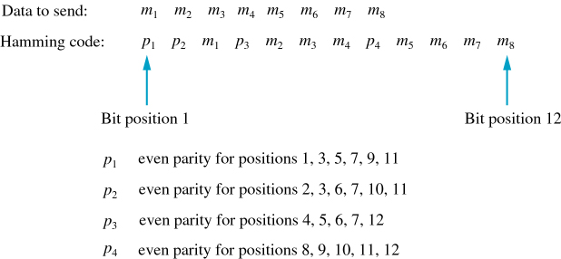
Error correction – Hamming Codes
Hamming Codes – Single-bit Error Correction
Which positions will parity checks cover? Where are they inserted?
Hamming Code for Single-bit Errors
Link Layer A

Slide 66
Error correction – Hamming Codes
Hamming Codes – Single-bit Error Correction
assume 4-bit binary number, b₁ b₂ b₃ b₄, where b_{i} = 0 if the parity p_{i} succeed, and 1 otherwise
Error Position | Binary b₄, b₃, b₂ & b₁ | Parity P₁ / Position | Parity P₂ / Position | Parity P₃ / Position | Parity P₄ / Position
0 (No Error) | 0000
1 | 0001 | 1
2 | 0010 |  | 2
3 | 0011 | 3 | 3
4 | 0100 |  |  | 4
5 | 0101 | 5 |  | 5
6 | 0110 |  | 6 | 6
7 | 0111 | 7 | 7 | 7
8 | 1000 |  |  |  | 8
9 | 1001 | 9 |  |  | 9
10 | 1010 |  | 10 |  | 10
11 | 1011 | 11 | 11 |  | 11
12 | 1100 |  |  | 12 | 12
Link Layer A

Slide 67
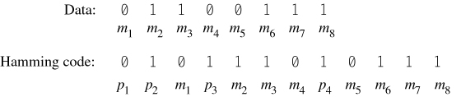
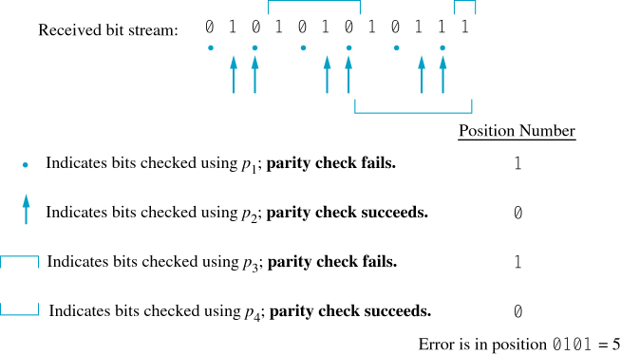
Error correction – Hamming Codes
Hamming Codes – Single-bit Error Correction
Example:
Bit Stream Before Transmission
Parity Checks of Frame After Transmission
Link Layer A

Slide 68
Error correction – Hamming Codes
Hamming Codes – Multiple-bit Error Correction
a more general Hamming code for multiple-bit error do exist
the number of extra parity bits becomes much larger in this case
when there are many possible codes, a reduction is needed in order to analyze them quickly
code Correlation can be used to achieve such reduction
when you have two, or more, Hamming codes, a Hamming distance is defined as the minimum number of bit changes that can lead one code to be detected as another
a Radius is defined as Hamming Distance / 2
Link Layer A

Slide 69
Error correction – Hamming Codes
Hamming Codes – Multiple-bit Error Correction
Example: Note: This topic is a major subject of higher-level/graduate courses. It is not a part of this course and you will not be examined on it. This example is just to give an extra knowledge on the subject.
Code 1 | Code 2 | Code 3
1 | 0 | 1
0 | 1 | 1
0 | 1 | 0
1 | 0 | 0
the codes have a minimum Hamming Distance of 2, or a Radius of 1
a code such as 0100 (which is not among the exact valid codes) can be coded as either code 3 with a missing first bit, or as code 2 with a missing third bit
a change of 2 bits may lead to two codes to be identical; or in other words decoded incorrectly (for example if code 3 changed to 0110, it will be decoded incorrectly as code 2)
Link Layer A

